Slide 1
Sensory Circuits
A brief introduction

Slide 2
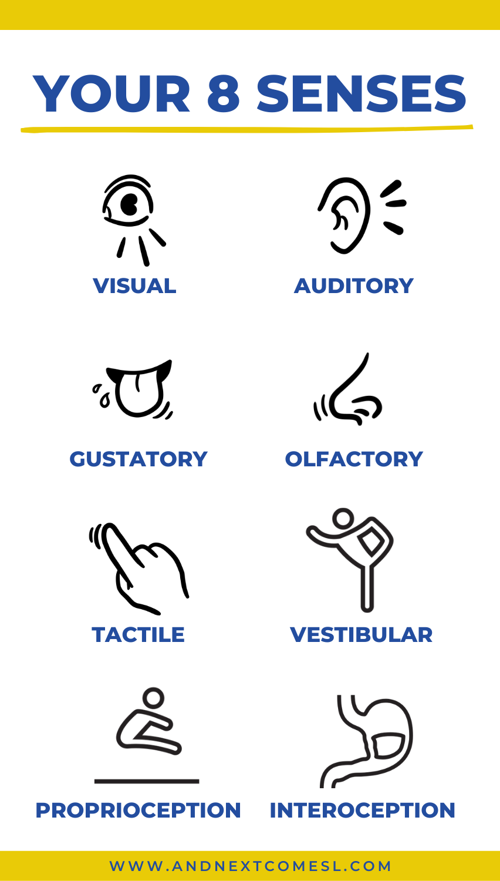
Sensory Integration is the process by which the brain receives, organises and processes all the information received from the senses. The senses include touch, sight, hearing, smell, taste, body position and movement (proprioception) and balance/position against gravity (vestibular). The information received from these senses help us to make sense of the world. Effective sensory integration and processing enables us to respond appropriately to different stimuli in our environment and informs our everyday functioning. A sensory circuit is a form of sensory integration intervention. It involves a sequence of physical activities that are designed to alert, organise and calm the child. The sensory circuit aims to facilitate sensory processing to help children regulate and organise their senses in order to achieve the ‘just right’ or optimum level of alertness required for effective learning. The circuit should be an active, physical and fun activity that children enjoy doing.
Little Miracles - Sensory Circuits (littlemiraclescharity.org.uk)

Slide 3
ALERTING
Activities that involved rapid, repeated movements of the head and body. This helps prepare the brain for learning.
ORGANISING
Activities that require children to plan their approach or involve doing more than one thing at a time in a set sequence. This supports focus.
CALMING
Activities often involving breathing or deep pressure. This helps ground the children, making sure they’re calm when they return to class.
Pursue scalable customer service through sustainable strategies​ Engage top-line web services with cutting-edge deliverables​
Cultivate one-to-one customer service with robust ideas​ Maximize timely deliverables for real-time schemas

Slide 4
Let’s give it a go!
We’d love to take some photos to share on our school website. Please let us know if you would prefer not to have your picture taken.

