Slide 1
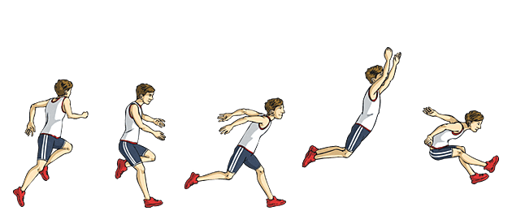
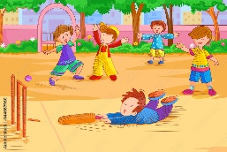
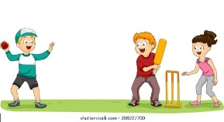
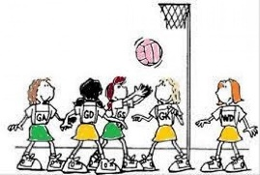
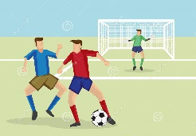
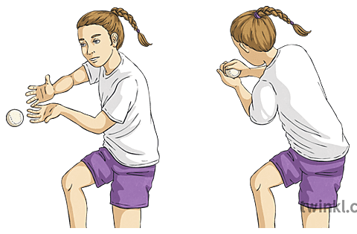
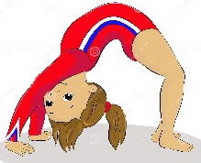
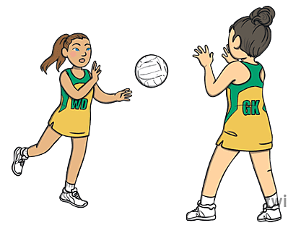
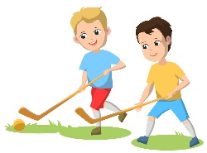
Athletics
Demonstrate a clear understanding of pace and use it to develop own and others sprinting technique.
Develop power, control and technique in the triple jump.
Develop power, control and technique when throwing discuss and shot put.
PE Learning Journey
Rounders
Strike a bowled ball with increasing accuracy and consistency.
Consistently select and apply the appropriate fielding action.
Consistently make good decision on who and when to pass in order to get batters out.
Consistently demonstrate good technique in catching skills under pressure.
Dance
Show controlled movements which express emotion and feeling.
Explore, improvise and combine movement dynamics to express ideas fluency, effectively on their own.
Use a variety of basic compositional principles when creating their own dances.
Demonstrate a clear understanding of timing in relation to the music throughout their performance.
Cricket
Strike a bowled ball with increasing accuracy and consistency.
Consistently select and apply the appropriate fielding action for the situation.
Consistently make good decisions on who and when to pass to in order to get batters out.
Consistently demonstrate good technique in catching skills under pressure.
YEAR
6
Netball
Develop making quick decisions about when, how and who to pass to.
Explore creating attacking tactics with others in response to the game
Explore creating and applying defending tactics with others in response to the game.
Move to the correct space when transitioning from attack to defence.
.
Gymnastics
Combine and perform gymnastic shapes more fluently and effectively.
Develop control in progression of a cartwheel and handstand.
Explore counter balances and counter tension balances.
Develop fluency and consistency in the straddle, forwards and backward roll.
Combine and preform a range of gymnastic jumps more fluently and effectively.
OAA
Pool ideas within a group, selecting and applying the best method to solve a problem.
Orientate a map efficiently to navigate around a course.
Inclusively communicate with others, share job roles and lead when necessary.
With increasing accurate the reflect on when and how they were successful at solving challenges and alter their methods tin order ti improve.
.
Athletics
Apply fluency and co-ordination when running for speed in relay changeovers.
Effectively apply speed appropriate for the event.
Develop power, control and consistency in jumping for distance.
Explore technique and rhythm in the triple jump.
Develop technique and power in javelin and shot put.
Fitness
Demonstrate improved body balance posture when changing direction.
Change their body position to maintain a controlled centre of gravity.
Demonstrate increased speed when coordinating bodies.
Identify the best pace for a set distance or time.
Demonstrate increased technique in body weight exercises.
Use their breath to increase their ability to move for sustained periods of time.
.
Football
Develop control when sending and receiving under pressure.
Select and apply a variety of dribbling techniques to game situations.
Explore creating tactics with others and applying them to game situations.
Develop tracking and marking with a variety of techniques and increase success.
Move to create space for themselves and others in their team.
Swimming
Demonstrate increased technique in a range of strokes, swimming 25m or more in distance.
Perform safe self-rescue in different water-based situations.
Athletics
Develop an understanding of speed and pace in relation to distance.
Develop power and speed in sprinting technique.
Develop technique when jumping for distance.
Explore power and technique when throwing for distance.
YEAR
5
Rounders
Explore defensive and driving hitting techniques and directional batting.
Develop over and underarm bowling technique.
Demonstrate clear technique when using a variety of throws under pressure.
Explore catching skills and apply these with some consistency in game situations.
Gymnastics
Perform shapes consistently and fluently to a high standard, sometimes linked with other gymnastic actions.
Explore progressions of a cartwheel.
Explore symmetrical and asymmetrical balances.
Develop control and fluency in the straight, barrel, forwards, straddle and backward roll.
Select a range of jumps to include in sequence work.
Dance
Choreograph planned dances by using, adapting and developing actions.
Confidently use dynamics to express difference dance styles.
Use direction and patterning to express different dance styles.
Confidently use formations, canon and unison to express a dance idea.
Perform dances expressively, using a range of performance skills.
Rounders
Develop batting technique consistent with the rules of the game.
Develop bowling with some consistency, abiding by the rules of the game.
Use overarm and underarm throwing with consistency.
Beginning to catch with one and two hands with some consistency in game situation.
Dance
Respond imaginatively to a range of stimuli related to character and narrative.
Change dynamics confidently within a performance to express changes in character.
Confidently use changes in level, direction and pathway.
Use action and reaction represent an idea.
Perform complex dances that communicate narrative and character well.
Gymnastics
Develop the range of shapes they use in their sequences
Develop strength in bridge and shoulder stand.
Develop control and fluent in balances.
Develop the straight, barrel, forward and straddle roll and perform with increased control.
Develop control in performing and landing rotation jumps.
YEAR
4
Netball
Develop passing to a teammate using a variety of techniques.
Develop decision making around when to pass and when to shoot.
Develop defending one on one and know when to win the ball.
Move into space to help their team keep possession and score goals.
Hockey
Develop passing to a teammate using a variety of techniques appropriate to the game.
Develop control whilst dribbling under pressure.
Develop decision making around when to pass and when to shoot.
Develop defending one on one and know when ot with the ball.
Move into space to help their team keep possession and score goals.
OAA
Plan independently and in small groups, implementing a strategy with increased success.
Identify key symbols on a map and use a key to help navigate around a grid.
Confidently communicate ideas and listen to others.
With increased accuracy critically reflect on when and why they were successful at solving challenges.
.

Slide 2
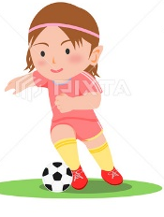
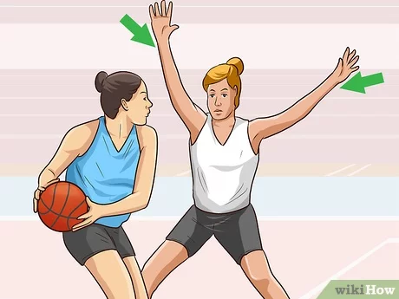
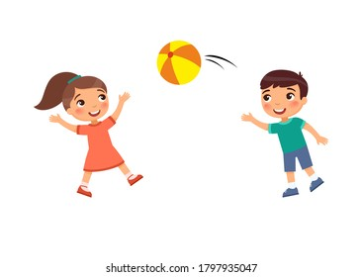
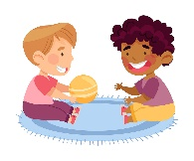
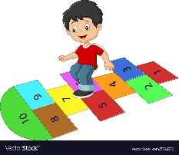
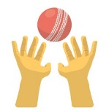
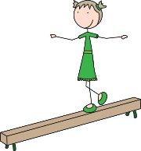
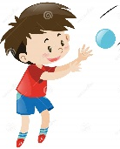
PE Learning Journey
Athletics
Develop the sprinting technique and apply it to relay events.
Develop technique when jumping for distance in a range of approaches and take off positions.
Explore the technique for a pull throw.
Football
Explore sending and receiving abiding by the rules of the game.
Explore dribbling the ball abiding by the rules of the game under some pressure.
Develop movement skills to lose a defender.
Track opponents to limit their scoring opportunities.
Develop moving with a ball towards goal with some control.
Netball
Explore sending and receiving abiding by the rules of the game.
Develop movement skills to lose a defender.
Track opponents to limit their scoring opportunities.
Develop moving with a ball towards a goal with some control.
Fundamentals
Change direction quickly
Demonstrate balance when performing other fundamental skills
Link jumping and hopping actions.
Jump and turn a skipping rope.
.
YEAR
Rounders
Begin to strike a bowled ball using different equipment.
Explore bowling and fielding skills to include a two-handfed pick up and long and short barriers.
Use overarm throwing in game situations.
Catch with some consistency in game situations.
3
Athletics
Develop the sprinting action.
develop jumping, hopping and skipping actions.
Explore safely jumping for distance and height.
Develop overarm throwing for distance.
Gymnastics
Explore matching and contrasting shapes.
Explore point and patch balances and transition smoothly in and out of them.
Develop the straight, barrel and forward roll.
Develop stepping into shape jumps with control.
Dance
Create actions in response to a stimulus individually and in groups.
Use dynamics effectively to express and idea.
Use directions to transition between formations.
Develop an understanding of formations.
Perform short, self-choreographed phrases showing and awareness of timing.
Invasion
Develop sending and receiving with increased control.
Explore dribbling with hands and feet with increasing control on the move.
Developing moving into space away from defenders.
Explore staying close to other players to ty and stop them getting the ball.
Explore moving with a ball towards a goal.
Sending and receiving
Understand how to roll a ball accurately to a target.
Track and receive a rolling ball.
Explore stopping, sending and receiving a ball.
Develop throwing and catching skills over a short and long distance with increase accuracy.
Fundamentals
Demonstrate balance when changing direction.
Demonstrate balance when performing movements.
Demonstrate jumping for distance, height and in different directions.
Demonstrate hopping for distance, height and in different directions.
Explore single and double bounce when jumping in a rope.
YEAR
2
Gymnastics
Explore using shape in different gymnastic balances.
Remember, repeat and link combinations of gymnastic balances.
Explore barrel, straight and forward roll and put into sequence work.
Explore shape jumps and take off combinations.
Dance
Accurately remember, repeat and link actions to express an idea.
Develop an understanding of dynamics.
Develop the use of pathways and travelling actions to include levels.
Explore working with a partner using unison, matching and mirroring.
Striking and fielding
Develop striking a ball with their hand and equipment with some consistency.
Understand that there are different roles within a fielding team.
Develop coordination and technique when throwing over and underarm.
Catch with two hands with some coordination and technique.
Athletics
Explore running at different speeds.
Develop balance when jumping and landing.
Explore hopping, jumping and leaping for distance.
Explore throwing for distance and accuracy.
Fundamentals
Demonstrate control in take off and landing when jumping.
Begin to explore hopping in different directions.
Show co-ordination when turning a rope.
Move with some control and balance.
Explore changing direction and dodging.
Discover how the body moves at different speeds.
Invasion
Explore sending and receiving with hands and feet.
Explore dribbling with hands and feet.
Explore changing direction to move away from a partner.
Explore tracking move to stay with a partner.
Recognise good space when playing games.
Sending and receiving
Develop rolling and throwing a ball towards a target.
Develop receiving a rolling ball and tracking skills.
Explore sending and receiving a ball with your feet.
Develop throwing and catching skills over a short and long distance.
YEAR
1
Gymnastics
Explore barrel, straight and forward roll progressions.
Explore shape jumps including jumping off low apparatus.
Perform balances making their body tense, stretch and curled.
Explore basic and still shapes straight, tuck, straddle and pike.
Games
Develop aim when throwing.
Follow instructions and move safely.
Understand how to play against a partner.
Develop co-ordination.
Explore striking.
Striking and fielding
Explore striking a ball with hands or equipment.
Develop tracking and retrieving a ball from their team.
Explore technique when throwing over and underarm.
Develop coordination and technique when catching.
Dance
Explore pathways within their performances.
Begin to explore actions and pathways with a partner.
Being to use counts within their performance.
Copy, remember and repeat actions to represent a theme.
Explore varying speeds to represent an idea.
Fundamentals
Use big steps to run and small steps to stop.
Hold your arms out to help bounce.
Bend your knees to land safely.
Use one foot to hop.
Hop then stop to help skip.
Ball skills
Look for a target when sending a ball.
Have your hands out ready to catch.
Know to watch the ball as it comes towards you and scoop it with two hands.
Know that keeping the ball close will help with control.
Intro into PE
Move safely around in space.
Understand how to follow instructions.
Stop safely and develop control when using equipment.
Take turns.
EYFS
Dance
Explore moving your body in different ways to create interesting actions.
Understand that you can change your action to show an idea.
Know if you move into a space it will help you to keep safe.
Know when watching others to sit quietly and clap.
Explore space.
Gymnastics
Make different shapes with your body.
Stay still when holding a balance.
Change your body shape to help roll.
Know bending your knees will help you land safely.

