Slide 1
1. Types of SEND
2. Identifying needs
3. Sharing concerns
4. Supporting pupils
5. Reviewing progress
Ormiston Meadows Academy
SEN Information Report
Reviewed September 2023
14. Helpful links
6. Evaluating provision
13. SEND policy
7. Role of Governors
12. Local Offer
11. Involving parents and children
10. Transition
9. Supporting Health and Wellbeing
8. Accessing the curriculum

Slide 2
1.Types of SEND:
Communication and Interaction
Autism Spectrum Conditions (inc. Asperger’s
Syndrome)
Speech and Language Difficulties
Cognition and Learning
Specific Learning Difficulties e.g. dyslexia
Downs Syndrome
Moderate Learning Difficulties
Social, Emotional and Mental Difficulties
ADHD
Attachment disorder
Mental health conditions
Self harm
Sensory and/or physical needs
Vision/ hearing impairment
Motor skill difficulties
Physical disabilities

Slide 3
The table below shows the number of children identified as having SEND within our school. This data was correct at the time of reporting (19th September 2023).
Need | Number | % of whole school | % of SEND pupils
Physical/Sensory | 4 | 2.1% | 9.3%
Cognition and Learning | 8 | 4.2% | 18.6%
Communication and Interaction | 21 | 10.9% | 48.8%
Social, Emotional and Mental Health | 10 | 5.2% | 23.3%
EHCP | 14 | 7.3% | 32.6%
SEND all groups | 43 | 22.3%
Ormiston Meadows Academy is also a Specialist Mainstream Resource Hub for children with physical disabilities. We have 6 specialist places and provide support to other schools working with children with physical disabilities.
https://ormistonmeadows.co.uk/key-info/send/hub-for-physical-disabilities

Slide 4
2. Identifying needs.
We do this by:
Listening to parental concerns
Listening to the child
Identification by teacher and inclusion team – for example through assessments, observations, discussions
Liaison with other educational professionals
Liaison with external agencies
School transfer information and transition meetings
Monitoring and assessment information

Slide 5
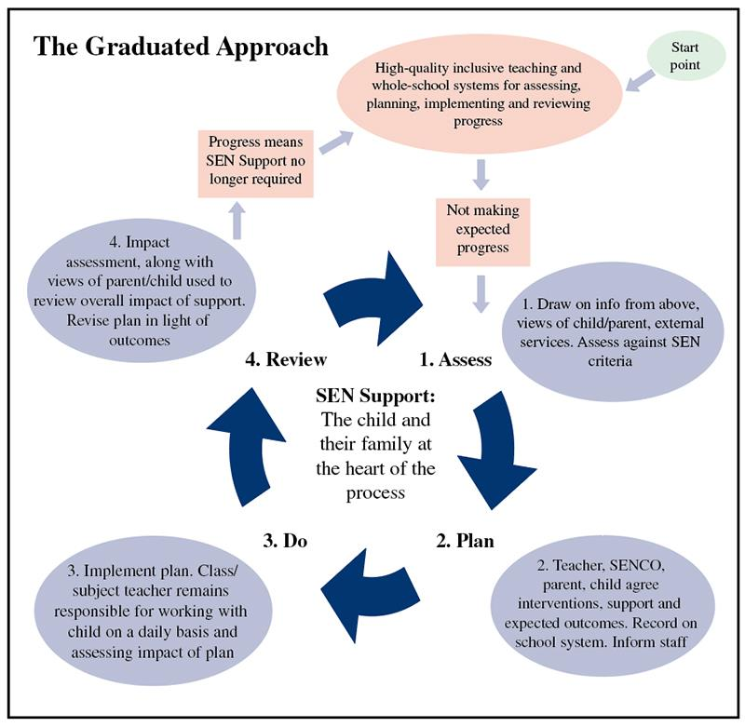
We follow a process to identify and address need called the Graduated Approach (you may also hear it referred to as Assess, Plan, Do, Review or APDR).

Slide 6
3. If you have a concern...
Firstly, raise any concerns with your child’s class teacher who can pass it on to the SENDCo.
The class teacher and SENDCo will work together to address these concerns.
The SENDCo and wider Inclusion Team are always happy to talk via phone, email or face-to-face.

Slide 7
SENDCo – Mrs Lizzie Oates
Tel 01733 231008
elizabeth.oates@ormistonmeadows.co.uk
I can :
Offer advice about how to identify if your child has any special educational needs.
Suggest ways to support your child at home
Make referrals to outside agencies
Lead multi-agency meetings to make sure your child’s needs are met in school
Provide advice on any family needs and suggest who can help
Should you wish to speak or meet with me then please ring the school office or speak with a member of our office staff to make an appointment.
Please note:
From November 2023 until July 2024 I will be on maternity leave. Mrs Elger will be acting SENCo during my absence. Her email is laura.elger@ormistonmeadows.co.uk

Slide 8
4. Supporting pupils
Targeted Specialist Support – Child needs a range of outside specialist support. | Child has multi agency involvement Child will be working towards, or will already have, a EHC plan. SENDCO to seek advice where necessary from outside specialists. Training for adults involved in the care of the child to be regular. Specialist assessments are used to recognise steps in learning. Monitoring of the support given to the child through range of means and by a range of specialists. Parents are contacted frequently and kept up to date on the day to day progress of the child through a key adult.
Targeted Support – Child needs resources and support from one or more outside agencies | APDR in place and reviewed regularly Advice sought by SENDCO to outside agencies. Child will be working towards , or already have, a co-ordinated plan in place. Additional training may be needed to support the child in school. Additional arrangements and time will be needed in order for the child to receive specialist support. Monitoring by SENDCO and other outside specialists. Complete CAF and start TAC
Universal Targeted Support – Needs are not being met through QFT | First point concern form received by SENDCO APDR put in place using resources from within school. Advice sought from SENDCO, Inclusion Manager and members of SLT Progress monitored through analysis of extra and additional support that has been given Monitoring by SENDCO through individual observations of the child Parents’ Meetings to share information and discuss support with parents Use of additional assessments , where needed.
Universal Support – has an identified additional need but is progressing well | Needs met through quality first teaching (QFT) Advice sought through Phase Leader and other teachers Progress monitored through Pupil Progress Meetings and data captures Monitoring by SENDCO through learning walks/book scrutinies/ pupil interviews Parents evenings used by Class Teacher as a time to share what is working well and next steps for the child Training for students and NQTs. Access to training as appropriate. Whole school policies and procedures in place.

Slide 9
Internal Specialist Support
Laura Elger (Vice Principal & Inclusion Manager) – overall strategic responsibility for SEND provision within the school
Lizzie Oates (SENDCo) – day-to-day responsibility for SEND provision within the school | Clare French (Attendance, Behaviour and Family Liaison Officer) – works with families and individual children | Jess Ward (Senior Mental Health Lead) – oversees mental health provision within the school
Deb Tilah (Inclusion Mentor) – provides day-to-day pastoral support and runs social/emotional groups | Naomi James (Lead Practitioner for SEND, OAT) – provides advice and support to members of the inclusion team
All teachers and teaching assistants have training and experience in meeting the needs of learners with SEND. Specialist training is provided as appropriate.

Slide 10
External Specialist Support
Parent Partnership Office – contact Marion Deeley Tel: (01733) 863979 or email: marion.deeley@peterborough.gov.uk | SEND Information Advice Support Service – Tel. 01733 863979 email pps@peterborough.gov.uk | Educational Psychologist Open Access Consultation Services – Tel: (01733) 863689
Family Voice – Tel: (01733) 313184 or email chair@familyvoice.info | National Autistic Society (Peterborough branch) -Jackie Luland Tel: (01733) 577366 or email jackieluland@aol.com | Dyslexia Association – Tel: (01733) 808076
Peterborough Area Down’s Syndrome Group - Trudy Bollons Tel: (01733) 575948 Peterborough and District | Little Miracles (Peterborough branch) – Tel: 01733 262226 or email peterborough@littlemiraclescharity.org.uk | Peterborough ADHD Support Group – Tel: (01733) 266702

Slide 11
External Specialist Support
Occupational Therapy Service – the SENDCo can refer directly to this service, but a referral can also come from a GP or paediatrician. | Support for Learning Ltd – an SEN consultant carries out assessments within the school setting. The assessments outline a child’s strengths and weaknesses and can identify specific learning difficulties eg Dyslexia. | Educational Psychology Therapy Service – an Educational Psychologist assesses, observes and facilitates interventions within the school setting to provide advice on educational needs. | Speech and Language Therapy Service – pupils can be referred and seen by appointment or assessed in the school setting. SALT programmes are provided and if necessary monitored by a therapist
School Nursing Team – they can provide support within the school setting or the family home | Visual Impairment Service – they provide advice to the school about how to support a pupil with a visual impairment | Hearing Impairment Service – they provide advice to the school about how to support a pupil with a hearing impairment | Community Paediatrician (NHS) – Family GP or SENDCo can refer children. They provide medical advice and can diagnose specific difficulties such as ADHD and Autism.
OT programmes are provided and if necessary monitored by an OT Physiotherapy Service – they provide support to school if a child has been referred to this service by a paediatrician | Autism Outreach – school can request support for a child diagnosed with Autism | Child and Mental Health Service (CAMHS) – support can be provided by a paediatrician | Pupil Referral Service – school can request support if a child is on the brink of exclusion

Slide 12
5. Reviewing progress
Teacher assessments
Academy data collection
Comparison with national data
Review meetings
Written reports
Additional intervention reports
Annual reviews and parents’ evenings
We will ensure that there are regular chances to assess and review children’s progress and we will use the following means :

Slide 13
We monitor the effectiveness of provision through…
Classroom observations
Data analysis
Pupil feedback
Parent consultations
OAT quality assurance arrangements
Multi agency reviews
6. Evaluating
Provision

Slide 14
7. Role of Governors
Roles and responsibilities of governors are:
Understanding how the school identifies children with SEND and what happens next
Understanding how the school allocates and spends SEND funding and who is responsible for this
Support the review process of the school’s SEND policy and ensure that the SEND provision reflects the changing needs of the school, its circumstances and the law
We have a governor with responsibility for SEND who visits the school regularly throughout the year
https://ormistonmeadows.co.uk/our-academy/governance

Slide 15
8. Accessing the Curriculum
We will provide the following to support children in their learning:
Pre-teaching
Small group interventions
Multi sensory resources
Adult support
Classroom strategies such as movement breaks, extra time, seating arrangements
Access to digital devices such as laptops and learning support software
Programmes set by external specialists for children with specific additional needs
Specialist equipment such as writing slopes, pencil grips, coloured overlays

Slide 16
Accessing Enrichment Opportunities.
We will provide skilled additional adults to support children, where appropriate.
We will have flexible arrangements to meet the individual needs of children who attend enrichment opportunities.
Accessing enrichment opportunities will be discussed with parents/ carers and any other external agencies so that accessibility needs are met.
We will carry out additional risk assessments and training all adults working with children who have specific needs.
We will look at adult to child ratios and additional resources that may be needed to support individual children when out of school for an educational or residential visit.

Slide 17
9. Supporting Health and Wellbeing
A whole school ethos that understands and supports children’s individual pastoral, social and medical needs.
Polar Bear Club: lunchtime provision for those children needing small group, supported playtime.
An Inclusion Team covering special needs, behaviour, wellbeing and mental health.
Care plans for children requiring medication, medical support or intimate care.
Support during transition between year groups and the move to secondary school.

Slide 18
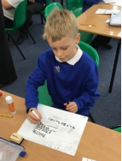
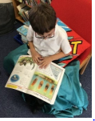
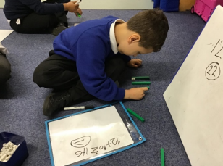
Pastoral
Support
Counselling
Family Support worker
Home School Liaison
EAL support in and out of class
Social skills groups
Emotional skills groups
1 to 1 support in class
1 to 1 support out of class
Pastoral leadership
School Council
PSHE lessons
Mental Health leadership
Behaviour support

Slide 19
10. Transition
Reception: staff visit pre-schools and conduct home visits, in addition to multi-agency transition meetings for those with high needs
Secondary: children have several opportunities to visit their new school and meet members of staff
Reception: children visit the school several times before starting, with and without their parents.
Secondary: transition meetings are held between staff from both schools and relevant information is shared
In year: staff liaise with the previous school to share information and attend transfer meetings where necessary
In year: there are opportunities for parents and children to meet with members of the Inclusion Team and/or class teacher before starting

Slide 20
11. Involving parents and children
We will ensure that we discuss any additional needs your child may have will all the right people. This will include you, as the parents, and the children themselves.
Parents
Parents’ evenings
Informal meetings
Written reports
Open door policy
Young People
Use of School Council members
Informal pupil interviews
Assessment for Learning opportunities in class
Open door policy

Slide 21
Complaints Procedure
If you have concerns about the school's SEND provision, please follow the complaints procedure as outlined in the complaints policy: Complaints.pdf (ormistonmeadows.co.uk)
This is a three-part process:
Informal
In the first instance, raise your concerns with your child's teacher. If they cannot resolve the issue by themselves, they will pass it on to the appropriate member of staff such as the SENDCO or Principal. It may be necessary to fill in a complaint form to aid in our understanding of your concerns.
Formal
At this stage, complaints must be made in writing and this can be done by either filling in a complaint form or using the 'Contact Us' function on the school's website. The complaint will be investigated by the Principal, or where the complaint concerns the Principal it will be investigated by a Regional Director for the trust.
Complaints panel
At this stage, the complainant can request a complaint panel hearing. They should contact OAT's Complaints Co-ordinator within three academy weeks of the date of the stage two complaint outcome letter if they want a complaint panel to be convened. This will be face to face unless reasonable adjustments are required.

Slide 22
Parental Comments
Parents of children with SEND have made the following comments about strengths of our current provision:
"Having sensory circuits in the morning"
"Sensory management"
"I love how the children are welcomed and made part of the class as a family"
"He loves his teacher and she is so understanding of his needs"
What future provision parents would like to see at Ormiston Meadows Academy:
"I would like to understand more about her level of learning so we could support more at home"
"More communication always welcome"
"Knowing more about strategies that work at school so we can use them at home too"

Slide 23
Children’s Comments
Children with SEND have made the following comments about our provision:
"I love the Acorn Room"
"My teacher helps me learn"
"I have my own timetable so I know what to do"
"If I do my learning, I get my reward time"
"S0metimes the teacher will write on a whiteboard and then I can copy it right"

Slide 24
12. Local Authority SEN offer.
The Local Authority’s Local Offer is can be found at
https://fis.peterborough.gov.uk/kb5/peterborough/directory/localoffer.page?familychannel=8

Slide 25
13. The academy SEND policy:
Ormiston Meadows Academy
SEND policy follows
the guidelines provided by
The Department for Education
in their document:
Special Educational Needs; Code of Practice 0 to 25 years. https://www.gov.uk/government/uploads/system/uploads/attachment_data/file/398815/SEND_Code_of_Practice_January_2015.pdf
Our SEND policy can be viewed under the SEND area of our website.
https://ormistonmeadows.co.uk/key-info/send

