Slide 1
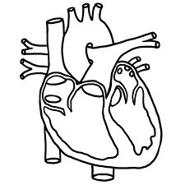
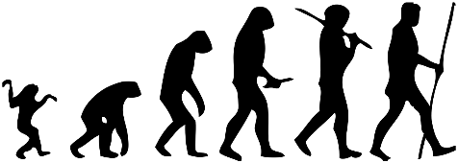
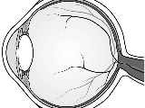
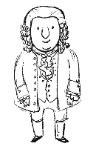
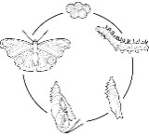
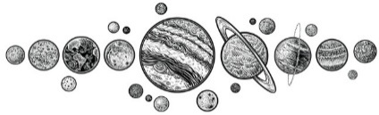
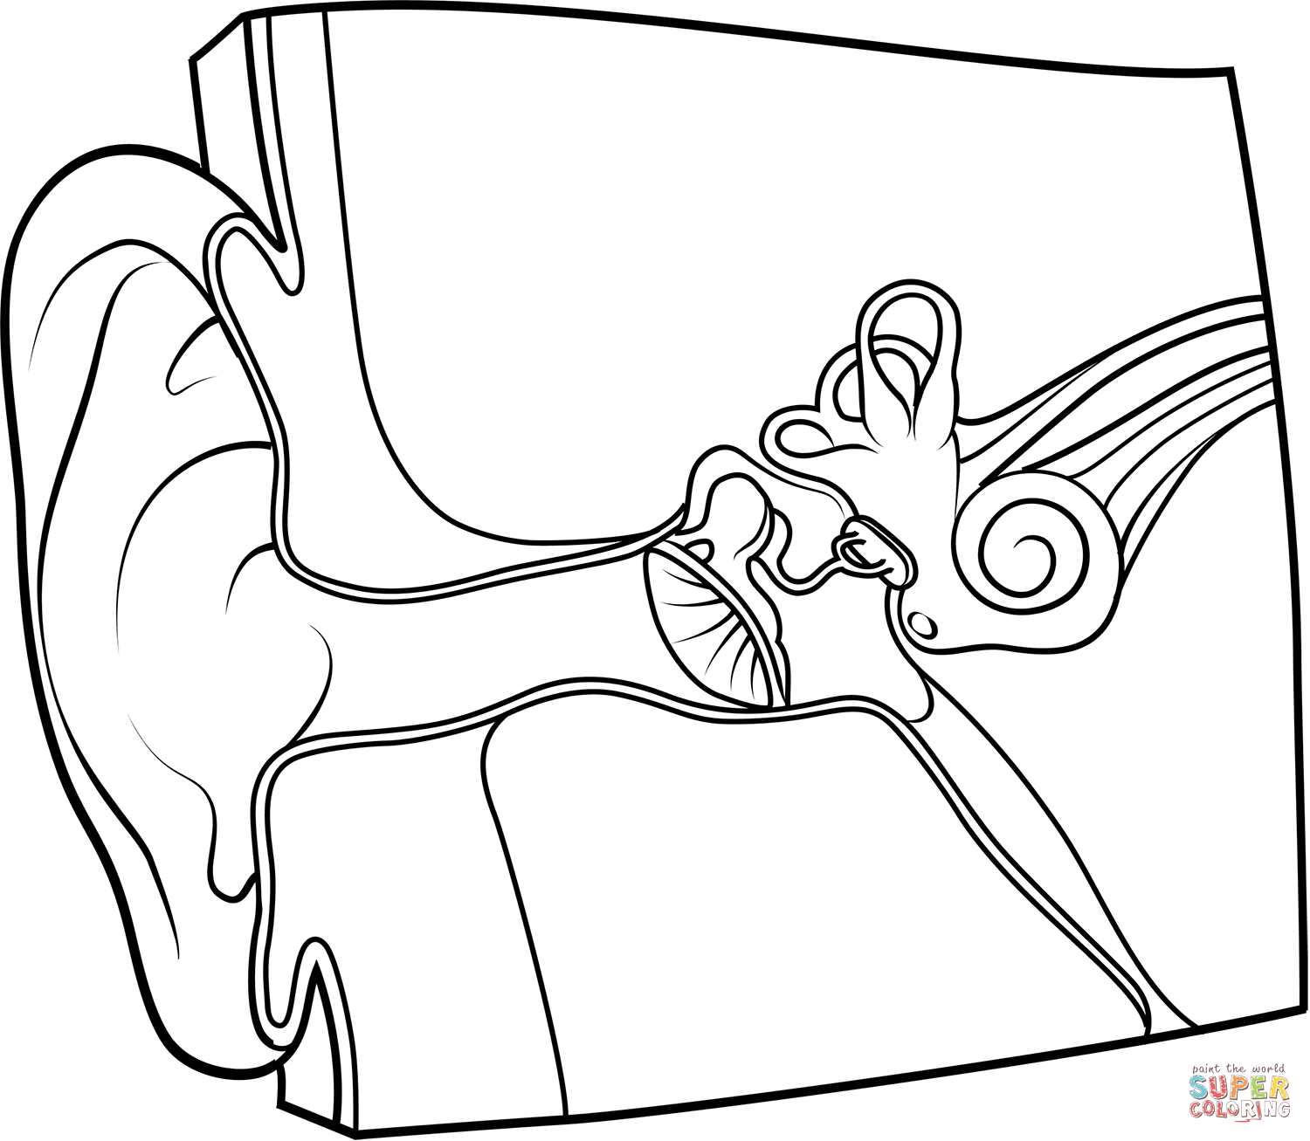
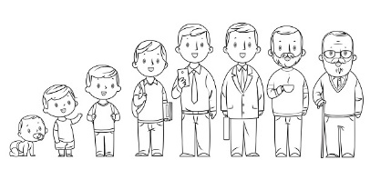
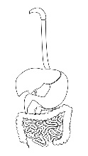
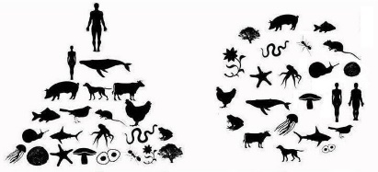
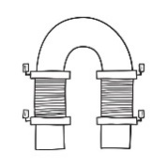
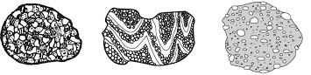
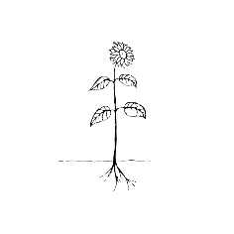
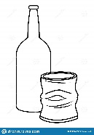
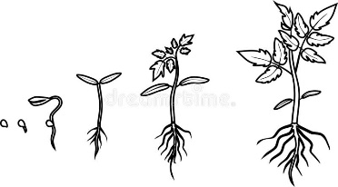
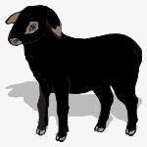
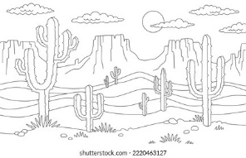
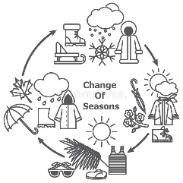
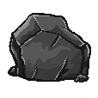
Science Learning Journey
Where are areas of surplus and deficit located globally?
Animals, including humans.
Electricity.
Evolution and inheritance.
YEAR
6
Light.
Living things and their habitats
Earth and space.
Properties and changes of material.
Living things and their habitats
5
YEAR
Forces.
Animals, including humans.
Sound.
States of matter.
Animals, including humans.
YEAR
4
Living things and their habitats
Electricity.
Animals, including humans.
Light.
YEAR
Forces and magnets.
3
Rocks.
Plants.
Use of everyday materials.
Animals, including humans.
Plants.
YEAR
2
Living things and their habitats
Seasonal changes.
Spring to Summer
Animals, including humans.
Seasonal changes. Autumn to Spring
YEAR
1
Sound
Plants.
Everyday materials.
Plants
Light
Living things and their habitats
Seasonal changes
Humans
EYFS
Animals including humans.
Plants.
Seasonal changes
Materials

