Slide 1

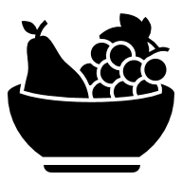




















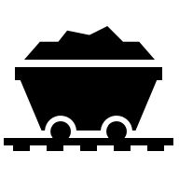



Where are areas of surplus and deficit located globally?
Design Technology Learning Journey
Food labels
Healthy communities
Programming
Systems and control – sensor alarms
YEAR
Food
Healthy eating in action
Seams and curves
Pockets and slots
Functional vs aesthetic
Inputs and outputs
Creating a programme
Fault finding
6
Textiles
Combining fabrics – accessible textiles
Food production and processing
Using our senses
Adapting recipes
Electrical Systems
Pulleys and gears – electric vehicles
5
YEAR
Computer Aided Design
3D shapes
Exploded diagrams
Switches
Circuit diagrams
Aerodynamics
Micro- controllers
Connecting components safely
Understanding data
Structures
CAD structures - architecture
Food
Creative cooking
Programming
Systems and control – data loggers
Food
Smart Seasonality
YEAR
Types of linkages
Assembling components
More skills
Seasonality
Healthy swaps
4
Mechanical Systems
Levers and linkages – interactive books
Structures
Shell structures - packaging
More skills
Food for special occasions
Familiar and unfamiliar foods
YEAR
3
Joining and cutting techniques
Fabric properties
Decorative techniques
Assemble and strengthen structures
Annotated sketches
Branding and promotion
Food
Global food
Material properties
Construction techniques
Textiles
From 2D to 3D
Mechanical Systems
Wheels and axels
Designing, finishing and testing a product
Mechanical Systems
Levers and sliders
More skills
Food origins
The Eatwell Guide
YEAR
Disassemble and assemble levers and sliders
Joining materials
2
Food
Healthy eating
Cooking
Let’s Start Cooking
YEAR
1
Exploring, reinforcing and testing structures
Fabrics
Simple sewing techniques
Using templates
Finishing techniques
Basic skills
Likes and dislikes
Structures
Frame structures - bridges
Textiles
Using templates - puppets
Joining materials
Comparing length, weight and capacity
Making and building
EYFS
Fine motor skills
Problem solving
Exploring materials

